Slide 1
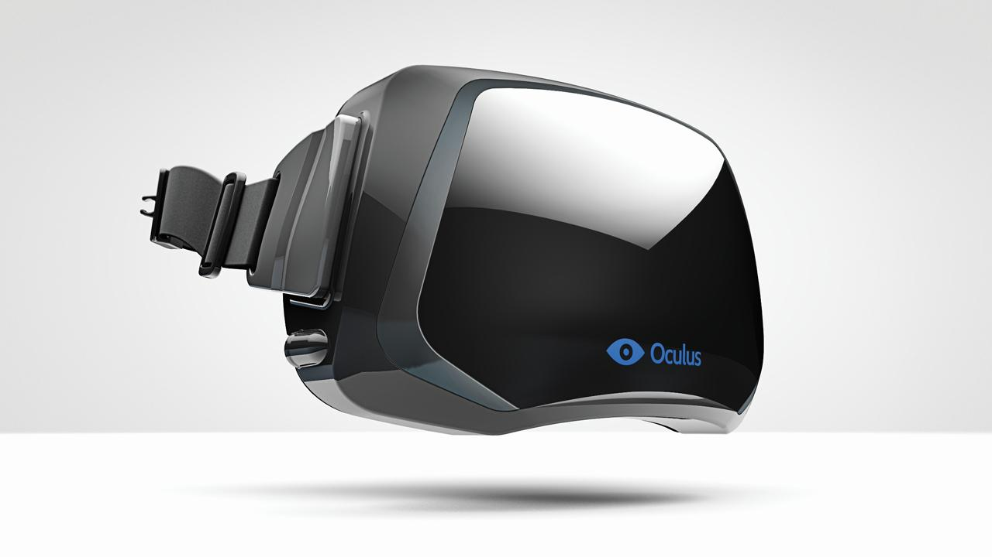
Oculus Rift Game
oculusvr.com
Group 4:
Ashkan Hosseini
Taylor Spencer
Customer:
Awesome Inc.

Slide 2
Outline
What are we making?
How are we going to make it?
How are we going to make it good?

Slide 3
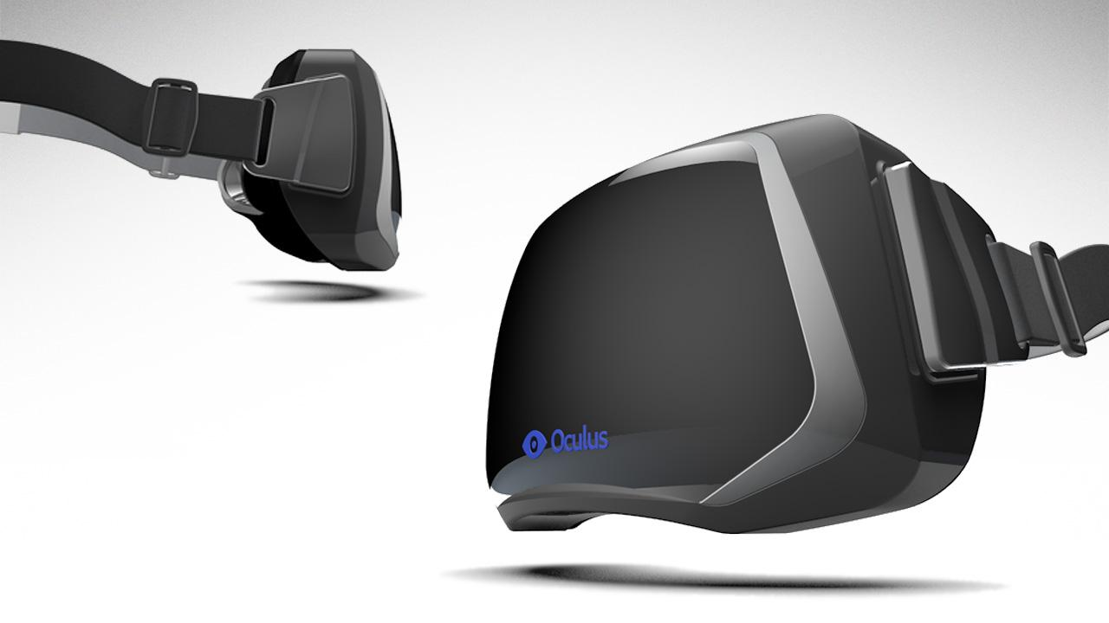
Introduction
What is the Rift?

Slide 4
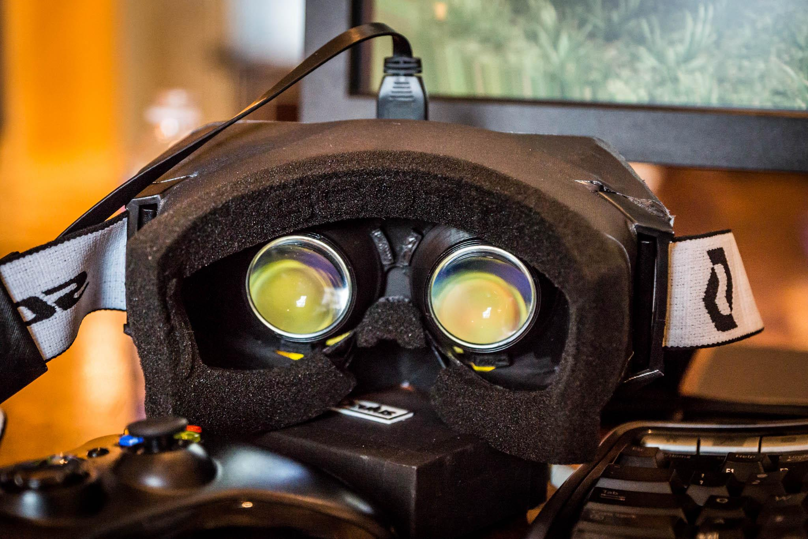
Introduction
Limitations
Low Resolution
High Latency

Slide 5
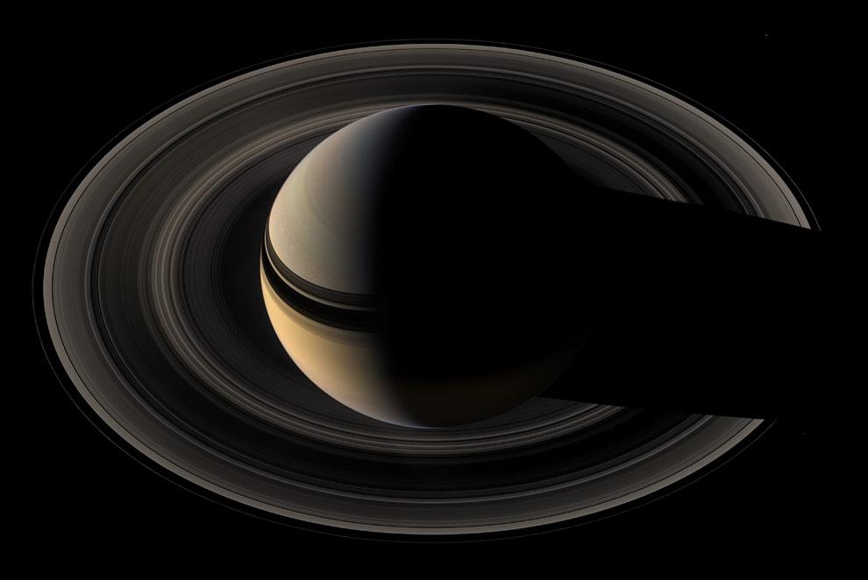
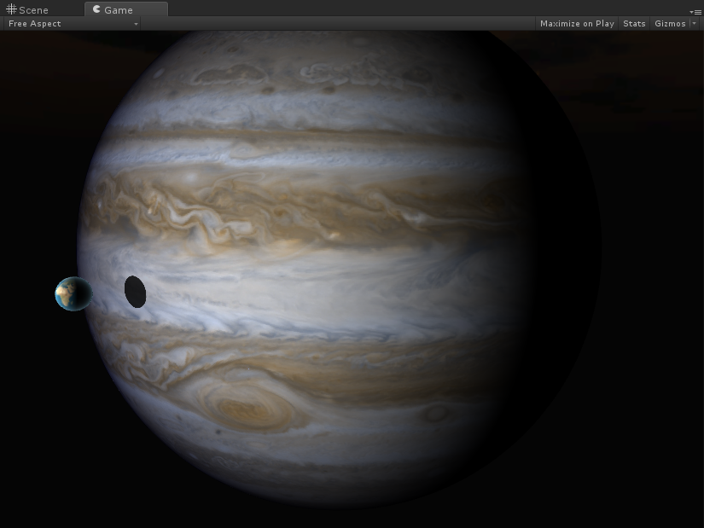
Introduction
What is our game?
Exploration
Space

Slide 6
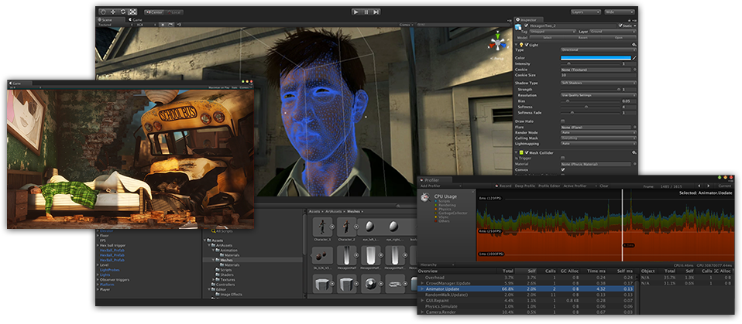
Architecture
Unity
Prebuilt Engine
Quick Iteration
Highly Supported

Slide 7
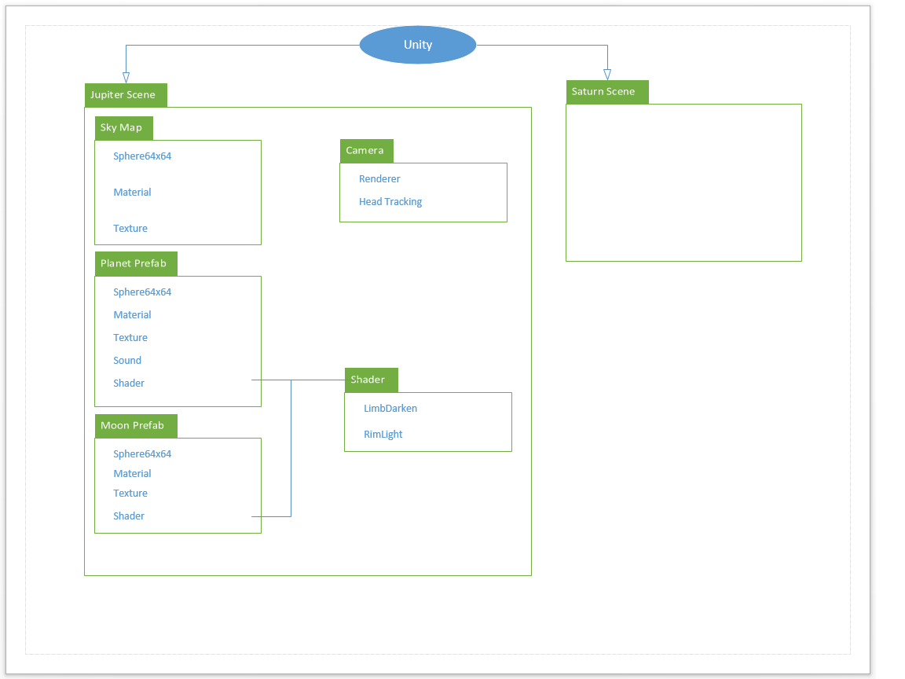
Architecture

Slide 8
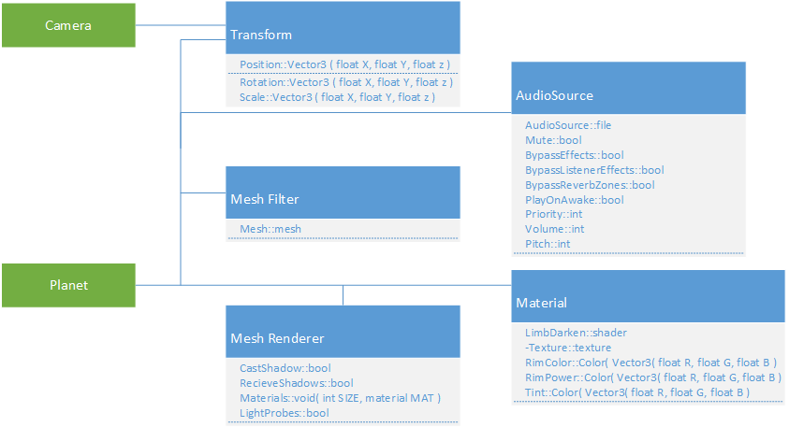
Architecture

Slide 9
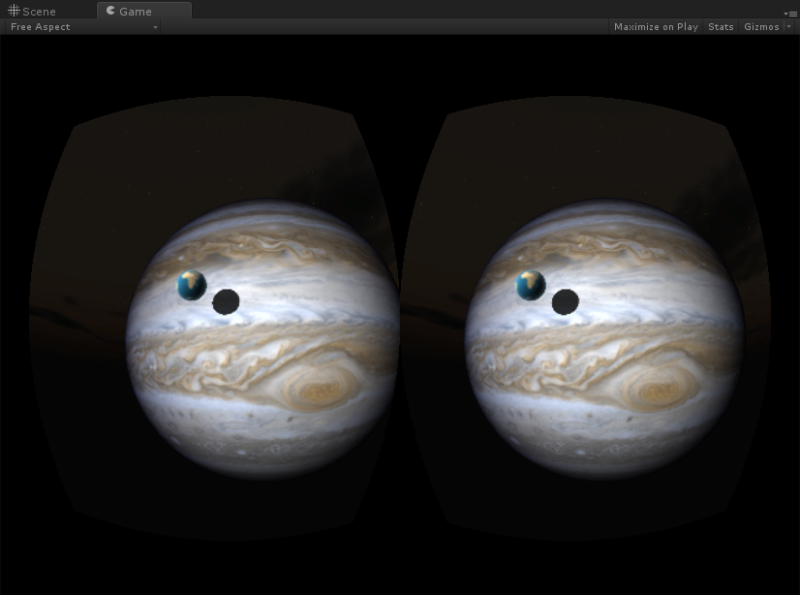
Detailed Design
Use Rift limitations to our advantage
Minimalist Game Design
Slow movement
Detail (or not)

Slide 10
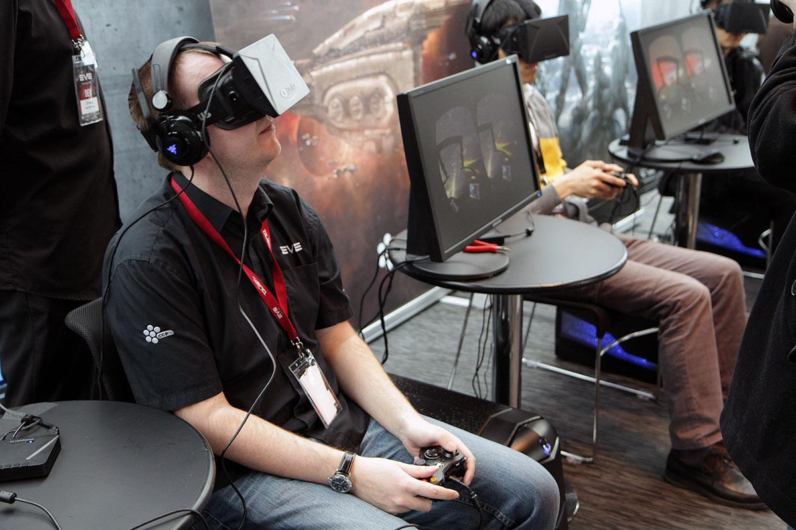
Testing
Make sure the player can finish
Visual Testing
Unit Testing
Player Testing

Slide 11
Summary

Slide 12
Q&A
?

